Slide 1
National Income and the Economy
Unit 1 — Foundations of Economic Analysis
This unit familiarises you with the basic features of an economy and the main indicators of its performance. By the end, you will be able to explain the concept of an economy, define national income and its relevance, and list fundamental questions about economic welfare and standard of living.
01
02
03
Understand the Economy
Define National Income
Key Economic Questions
Explain the concept and dimensions of an economy
Discuss its relevance and various uses in policy
List fundamental questions about welfare and living standards

Slide 2
Meaning of an Economy
The term "economy" has many dimensions — it may refer to a region, an entire country, or the whole world (e.g., Haryana's economy, the Indian economy, the World economy). In this unit, we confine the concept to a country.
Production
Consumption
Investment
Carried out in farms, factories, shops, banks, hospitals, schools, railways, airlines, and government offices.
By households (food, clothing, housing) and by government (hospitals, schools, police, military, public utilities).
Purchases of machines, buildings, furniture, and stocks of raw materials that add to capital assets of production units.
A study of production, consumption, and investment activities carried out by people and institutions in a country is the study of the economy of that country.

Slide 3
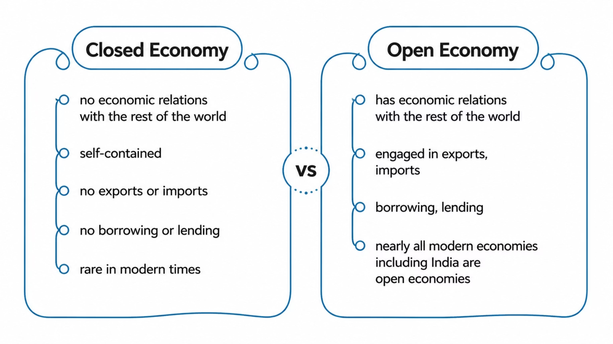
Closed vs. Open Economy
India is an open economy, engaged in exports, imports, borrowing, lending, and other activities with other countries. At present, it is difficult to find an example of a closed economy — nearly all economies of the world are open economies.

Slide 4
Meaning of National Income
National income of a country is the sum of incomes earned by its residents from the factor services rendered to the production units both within and outside the geographical boundaries of the country.
Who is a "Resident"?
What is "Factor Income"?
A person or institution whose economic interest (production, consumption, investment) lies in the country in which they live. Citizenship is not the criterion — economic interest is. NRIs are Indian citizens but residents of another country.
Income derived by owners of the four factors of production:
Land (natural resources) → Rent
Labour (human resources) → Wages/Salaries
Capital (man-made resources) → Interest
Entrepreneurship → Profit
In technical national income accounting, national income is called Net National Product at Factor Cost.

Slide 5




Three Angles of National Income
Incomes are created in production units, received by factor owners, and then spent on goods and services. These three stages give us three ways of measuring national income — all yielding the same aggregate.
Production Angle
Income Distribution Angle
Expenditure Angle
Reveals contribution of Primary, Secondary, and Tertiary sectors to national income.
Reveals distribution of income among labour, property, entrepreneurial, and land-owning classes.
Reveals purchases for consumption (private & government) and investment (domestic & foreign/net exports).
Domestic investment within the economic territory is termed Gross Domestic Capital Formation. Foreign investment is given by net exports (Exports − Imports).

Slide 6

Nine Key Questions About an Economy
Laypersons may observe what is happening around them but cannot get definitive answers without data. The clues to all the following questions can be found in the data collected during the process of estimating national income.
1
2
3
Is the economy growing?
Are all parts growing?
Are people getting more goods & services?
4
5
6
Is growth benefiting all sections?
Is the standard of living rising?
What is the future of the economy?
7
8
9
How rich or poor is the economy?
Is government spending enough on welfare?
How should funds be allocated?

Slide 7
Q1: Is the Economy Growing?
The rate of economic growth reported in news is simply the rate of growth of National Income at Constant Prices. "Constant prices" measures the net availability of physical goods and services — an index of physical production, eliminating the effect of price changes.
Illustration: If National Income at Constant Prices is Rs. 1,000 crores in 2003 and Rs. 1,060 crores in 2004, the change is Rs. 60 crores.
This 6% rise in National Income at Constant Prices is the rate of growth of the country during that year.

Slide 8
Q2 & Q3: Sectoral Growth & Per Capita Income
Are All Parts of the Economy Growing?
Are People Getting More Goods & Services?
The economy is divided into three sectors:
The measure used is Per Capita Income at Constant Prices:
Primary: Farming, mining, fishing, animal husbandry — exploiting natural resources
Secondary: Manufacturing (bicycles, scooters, TV) — transforming goods
Tertiary: Banks, transport, insurance, government — producing services
A rise in per capita income means people are, on average, getting more goods and services. However, national income can rise while per capita income falls if population grows faster.
Example — India 1976–77: National income rose by 0.9%, but per capita income fell by 1.3% because population grew at 2.2%.
If agriculture suffers, raw material supply to secondary sector falls, reducing demand for services. All sectors are interdependent. Data from the production method reveals sectoral performance.

Slide 9
Q4: Is Growth Benefiting All Sections?
National income may rise but may not equally benefit all sections of society. The income distribution approach reveals inequalities. Consider the following illustration based on imaginary data:
Year
Rural Sector
Urban Sector
Economy (Total)
Rate of Growth
2003
80
120
200
—
2004
75
135
210
+5%
Rate of Growth
(−) 6.25%
+12.5%
+5%
—
Though national income grew by 5%, the rural sector's income fell by 6.25% while the urban sector grew by 12.5%. This reveals income inequality. The government's special concern is the share of the Labour class — the majority in any country — as declining labour share can cause political, social, and economic unrest.

Slide 10
Q5 & Q6: Standard of Living & Economic Future
Is the Standard of Living Rising?
What is the Future of the Economy?
Standard of living is determined by what people spend on consumer goods and services. Dividing total consumption expenditure by population gives a measure of average standard of living.
The expenditure approach classifies total expenditure into:
Just as individuals save and invest for the future, society as a whole saves and invests. More investment leads to a bigger flow of goods and services in future years.
The expenditure approach collects data on:
Domestic Capital Formation — investment within the economic territory
Net Exports (Exports − Imports) — foreign investment
Private consumption expenditure — by households
Government consumption expenditure — free services to people
Together, these determine what is in store for society's future — which is why every government lays great emphasis on fresh investments.
Both affect the standard of living. Detailed examination of consumption data helps in policy measures for different sections of society.

Slide 11

Q7: How Rich or Poor is the Economy?
This is a relative question, answered by comparing national income with other economies. Nearly all countries estimate their national incomes, enabling international comparisons.
Per Capita Income Comparison (1994)
Adjusting for Price Levels
Scope of Comparison
A US dollar spent in the USA buys fewer goods than the same dollar spent in India. Differences in price levels are eliminated using suitable price index numbers to make comparisons meaningful.
We can compare not only income levels but also consumption expenditure, investments, and government expenditures. For international projects, costs can be shared according to the income levels of participating countries.
India: US$ 320 | USA: US$ 25,880 — an average American earned 80 times that of an average Indian.

Slide 12
Q8 & Q9: Welfare Spending & Fund Allocation
Is Government Spending Enough on Welfare?
How Should Funds Be Allocated?
It is the basic duty of every government to maintain law and order, guard the country, and provide basic facilities — water supply, education, medical care, roads. The expenditure method collects data on:
Fund allocation requires knowing: (a) from whom a sector buys inputs, and (b) to whom it sells its output. This technological interdependence is critical.
For example, allocating funds to agriculture without funding fertiliser, pesticide, tractor, and transport sectors means targets may not be achieved.
This information is summarised in the Input-Output Accounting Matrix, prepared from national income data, and serves as a guide to the Planning Commission or similar bodies.
Police, courts, military
Sanitation, schools, colleges
Roads and hospitals
This variable is called Government Final Consumption Expenditure — a measure of the value of free services rendered to the people.

Slide 13
Key Words
Closed Economy
Open Economy
Economy
Resident
An economy which does not have economic relations with the rest of the world.
An economy which has economic relations with the rest of the world.
Economic aspects of a country — basically production, consumption, and investment activities.
A person or institution whose economic interest lies in the country in which they live or are located.
Factor Income
National Income
Per Capita Income
Primary / Secondary / Tertiary Sector
Income accruing to a factor of production (rent, wages, interest, profit).
Sum total of factor incomes accruing to the residents of a country during a given year.
National income divided by population.
Natural resource exploitation / goods transformation / service production units respectively.
Consumption / Investment Expenditure
Expenditure on goods for want satisfaction / expenditure on capital goods like machines and equipment.

Slide 14
Check Your Progress — Answers & Hints
Check Your Progress 1
Check Your Progress 3
A resident is one whose economic interest (production, consumption, investment) lies in the economy in which they live.
Land → Rent; Labour → Wages/Salaries; Capital → Interest; Entrepreneurship → Profit.
The expenditure approach reveals who purchases goods and services — how much is bought for consumption and how much for investment.
c) Consumption expenditure.
c) Expenditure method.
By looking at Government Final Consumption Expenditure — a measure of free services rendered to the people.
With the help of the Input-Output Transactions Matrix, which records purchases by industrial sectors from other industrial sectors, prepared from national income data.
Check Your Progress 2
b) National income at constant prices.
a) Primary sector.
By estimating per capita income at constant prices = National Income (constant prices) ÷ Population.

Slide 15




Let Us Sum Up
National income data has great relevance in the study of an economy. The study of an economy is the study of production, consumption, and investment aspects of the residents of a country.
Economic Growth
Equity & Living Standards
Rate of growth of national income at constant prices measures the rate of growth of the economy.
Income-distribution angle reveals equitableness; consumption expenditure data measures standard of living.
Future & Welfare
International Comparison
Savings and investment data predict economic future; government consumption expenditure indicates welfare activities.
Comparing national incomes across countries reveals how rich or poor an economy is relative to others.
Recommended Reading: Abraham (1969), Agarwala (1998), Beckerman (1976), Hicks (1971), Ruggles & Ruggles (1956), Studenski (1958).

